Slide 1
Supplementary Slides

Slide 2
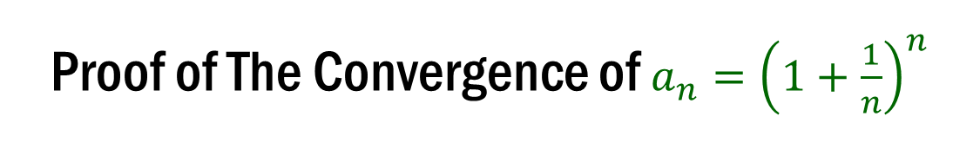
Proof of The Convergence of ${a_{n}=\left(1+\frac{1}{n}\right)}^{n}$

Slide 3
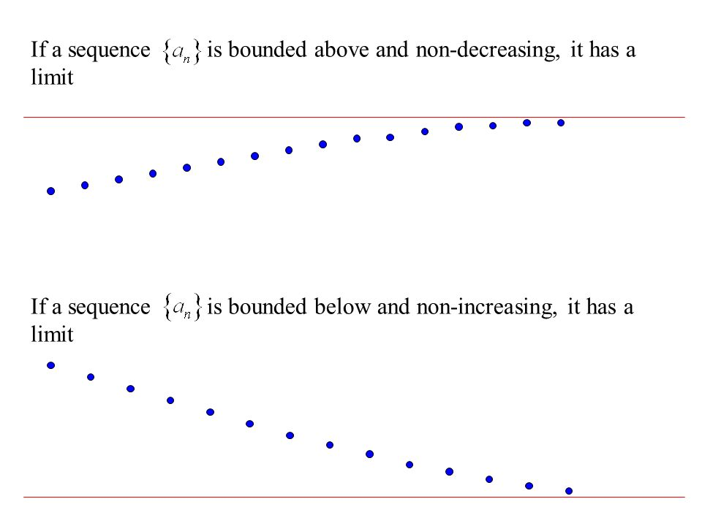
Monotone Convergence Theorem (MCT)
Monotone Convergence Theorem (MCT): If a sequence $\{a_{n}\}$is monotone and bounded, it is convergent (i.e., it has a limit).

Slide 4
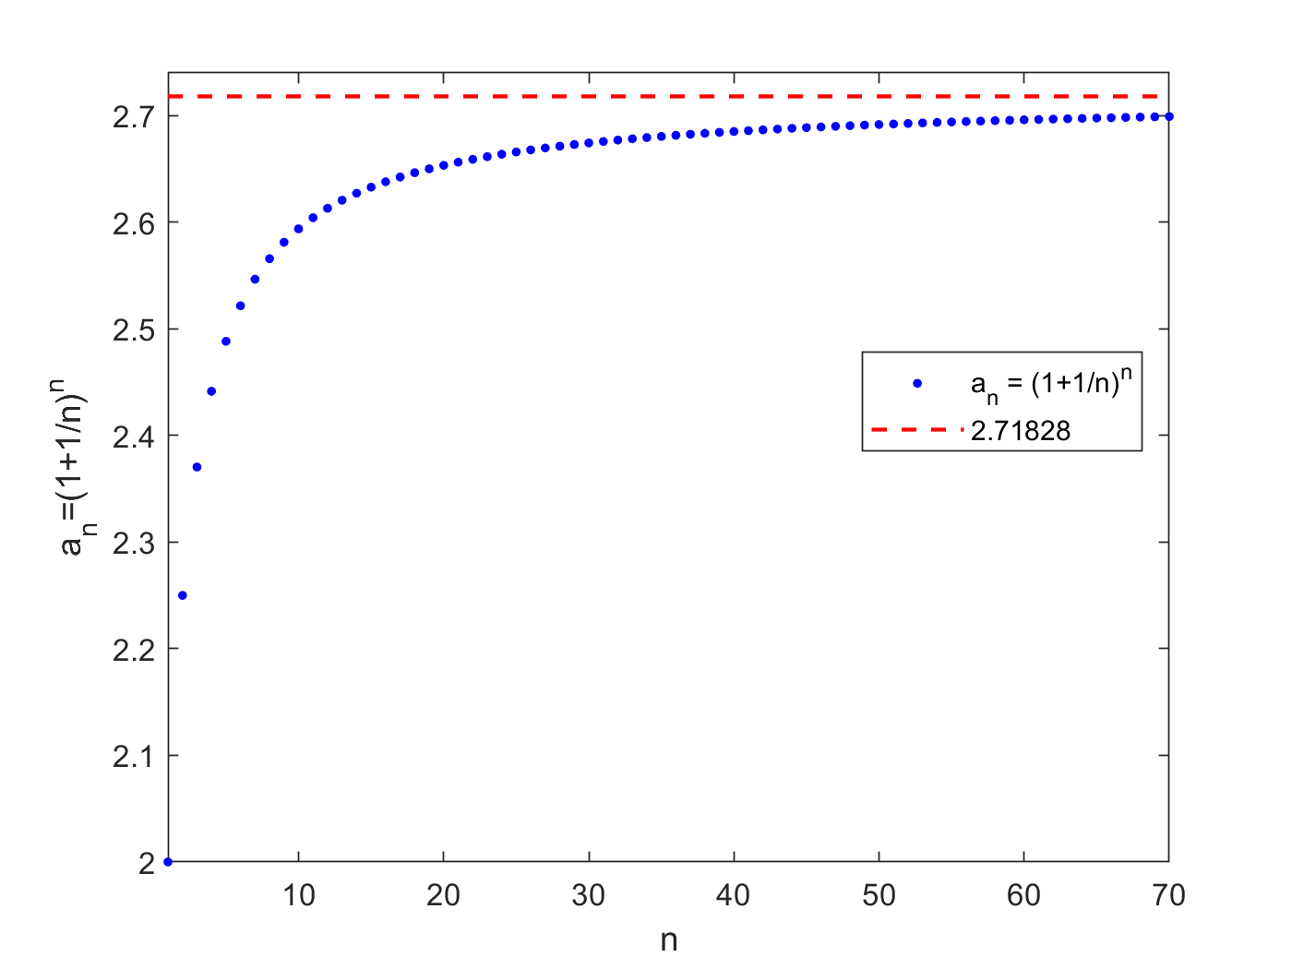
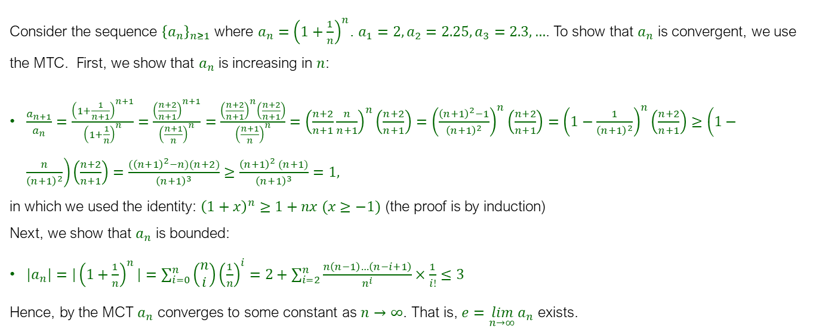

Proof of The Convergence of ${a_{n}=\left(1+\frac{1}{n}\right)}^{n}$
Consider the sequence ${\left\{a_{n}\right\}}_{n≥1}$ where ${a_{n}=\left(1+\frac{1}{n}\right)}^{n}$. $a_{1}=2,a_{2}=2.25,a_{3}=2.3,…$. To show that $a_{n}$ is convergent, we use the MTC. First, we show that $a_{n}$ is increasing in $n$:
$\frac{a_{n+1}}{a_{n}}=\frac{{\left(1+\frac{1}{n+1}\right)}^{n+1}}{{\left(1+\frac{1}{n}\right)}^{n}}=\frac{{\left(\frac{n+2}{n+1}\right)}^{n+1}}{{\left(\frac{n+1}{n}\right)}^{n}}=\frac{{\left(\frac{n+2}{n+1}\right)}^{n}\left(\frac{n+2}{n+1}\right)}{{\left(\frac{n+1}{n}\right)}^{n}}={\left(\frac{n+2}{n+1}\frac{n}{n+1}\right)}^{n}\left(\frac{n+2}{n+1}\right)={\left(\frac{{\left(n+1\right)}^{2}−1}{{\left(n+1\right)}^{2}}\right)}^{n}\left(\frac{n+2}{n+1}\right)={\left(1−\frac{1}{{\left(n+1\right)}^{2}}\right)}^{n}\left(\frac{n+2}{n+1}\right)≥\left(1−\frac{n}{{\left(n+1\right)}^{2}}\right)\left(\frac{n+2}{n+1}\right)=\frac{{(\left(n+1\right)}^{2}−n)(n+2)}{{\left(n+1\right)}^{3}}≥\frac{{\left(n+1\right)}^{2} (n+1)}{{\left(n+1\right)}^{3}}=1,$
in which we used the identity: ${\left(1+x\right)}^{n}≥1+nx (x≥−1)$ (the proof is by induction)
Next, we show that $a_{n}$ is bounded:
${{|a}_{n}|=|\left(1+\frac{1}{n}\right)}^{n}|=\sum_{i=0}^{n}{\left(\begin{aligned}n \\ i\end{aligned}\right){\left(\frac{1}{n}\right)}^{i}=2+\sum_{i=2}^{n}{\frac{n\left(n−1\right)…\left(n−i+1\right)}{n^{i}}}×\frac{1}{i!}≤3}$
Hence, by the MCT $a_{n}$ converges to some constant as $n→∞$. That is, $e=\lim_{n→∞}{a_{n}}$ exists.

Slide 5
Properties of Exponential Functions for General Real Numbers

Slide 6

Rationale for the Proof
We already know that $b^{x}b^{y}=b^{x+y}$ holds for integers $x$ and $y$. The idea is to extend this intuition to real numbers by using limits. We first show that the idea can be extended to any two rational numbers, and then extend it to any two real numbers by using the property that any real number is the limit of a sequence of rational numbers.

Slide 7
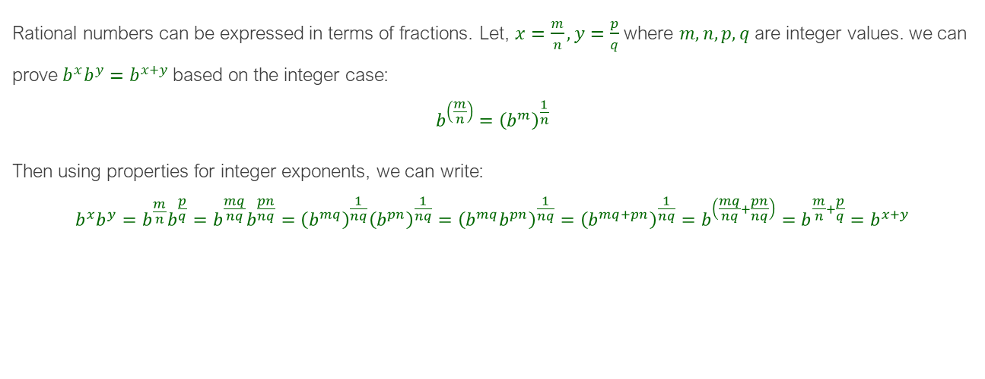
1. Case for Rational Numbers
Rational numbers can be expressed in terms of fractions. Let, $x=\frac{m}{n},y=\frac{p}{q}$ where $m,n,p,q$ are integer values. we can prove $b^{x}b^{y}=b^{x+y}$based on the integer case:
$$b^{\left(\frac{m}{n}\right)}={\left(b^{m}\right)}^{\frac{1}{n}}$$
Then using properties for integer exponents, we can write:
$$b^{x}b^{y}=b^{\frac{m}{n}}b^{\frac{p}{q}}=b^{\frac{mq}{nq}}b^{\frac{pn}{nq}}={\left(b^{mq}\right)}^{\frac{1}{nq}}{\left(b^{pn}\right)}^{\frac{1}{nq}}={\left(b^{mq}b^{pn}\right)}^{\frac{1}{nq}}={\left(b^{mq+pn}\right)}^{\frac{1}{nq}}=b^{\left(\frac{mq}{nq}+\frac{pn}{nq}\right)}=b^{\frac{m}{n}+\frac{p}{q}}=b^{x+y}$$

Slide 8
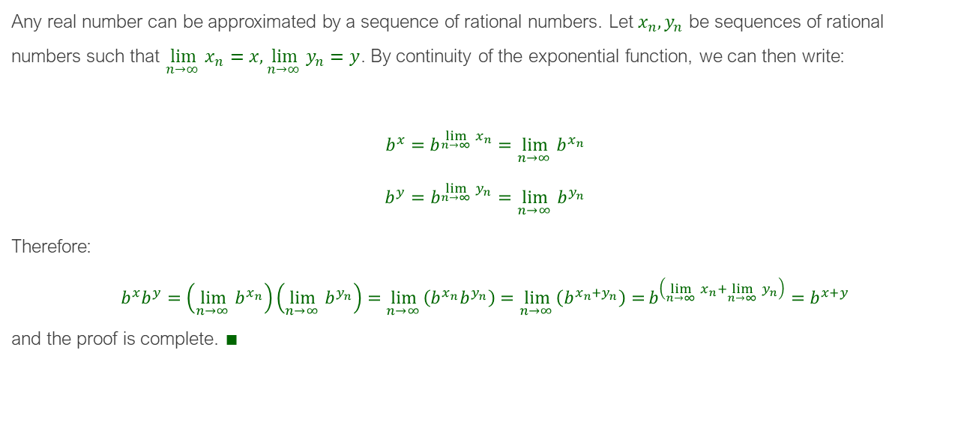
2. Case for Real Numbers as Limits of Rational Numbers
Any real number can be approximated by a sequence of rational numbers. Let $x_{n},y_{n}$ be sequences of rational numbers such that $\lim_{n→∞ }{x_{n}}=x,\lim_{n→∞ }{y_{n}}=y$. By continuity of the exponential function, we can then write:
$$b^{x}=b^{\lim_{n→∞ }{x_{n}}}=\lim_{n→∞ }{b^{x_{n}}}$$
$$b^{y}=b^{\lim_{n→∞ }{y_{n}}}=\lim_{n→∞ }{b^{y_{n}}}$$
Therefore:
$$b^{x}b^{y}=\left(\lim_{n→∞ }{b^{x_{n}}}\right)\left(\lim_{n→∞ }{b^{y_{n}}}\right)=\lim_{n→∞ }\left(b^{x_{n}}b^{y_{n}}\right)=\lim_{n→∞ }\left(b^{x_{n}+y_{n}}\right)=b^{\left(\lim_{n→∞ }{x_{n}}+\lim_{n→∞ }{y_{n}}\right)}=b^{x+y}$$
and the proof is complete. $∎$

Slide 9
L'Hôpital’s Rule for Fractional Limits

Slide 10

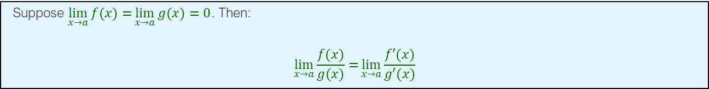
L'Hôpital’s Rule
Suppose $\lim_{x→a}{f(x)=}\lim_{x→a}{g(x)=0}$. Then:
$$\lim_{x→a}{\frac{f(x)}{g(x)}=}\lim_{x→a}{\frac{f′(x)}{g′(x)}}$$
Proof:
$$\lim_{x→a}{\frac{f(x)}{g(x)}=}\lim_{x→a}{\frac{\frac{f\left(x\right)−0}{x−a}}{\frac{g\left(x\right)−0}{x−a}}}=\frac{\lim_{x→a}\frac{f\left(x\right)−f(a)}{x−a}}{\lim_{x→a}\frac{g\left(x\right)−g(a)}{x−a}}=\frac{f′(a)}{g′(a)}=\lim_{x→a}{\frac{f′(x)}{g′(x)}}$$
Example:
$$\lim_{x→1}{\frac{x^{2}−1}{x−1}=}\lim_{x→1}{(x+1)=2}$$
With L’Hopital:
$$\lim_{x→1}{\frac{x^{2}−1}{x−1}=}\lim_{x→1}{\frac{2x}{1}=2}$$

Slide 11
More on R Programming

Slide 12
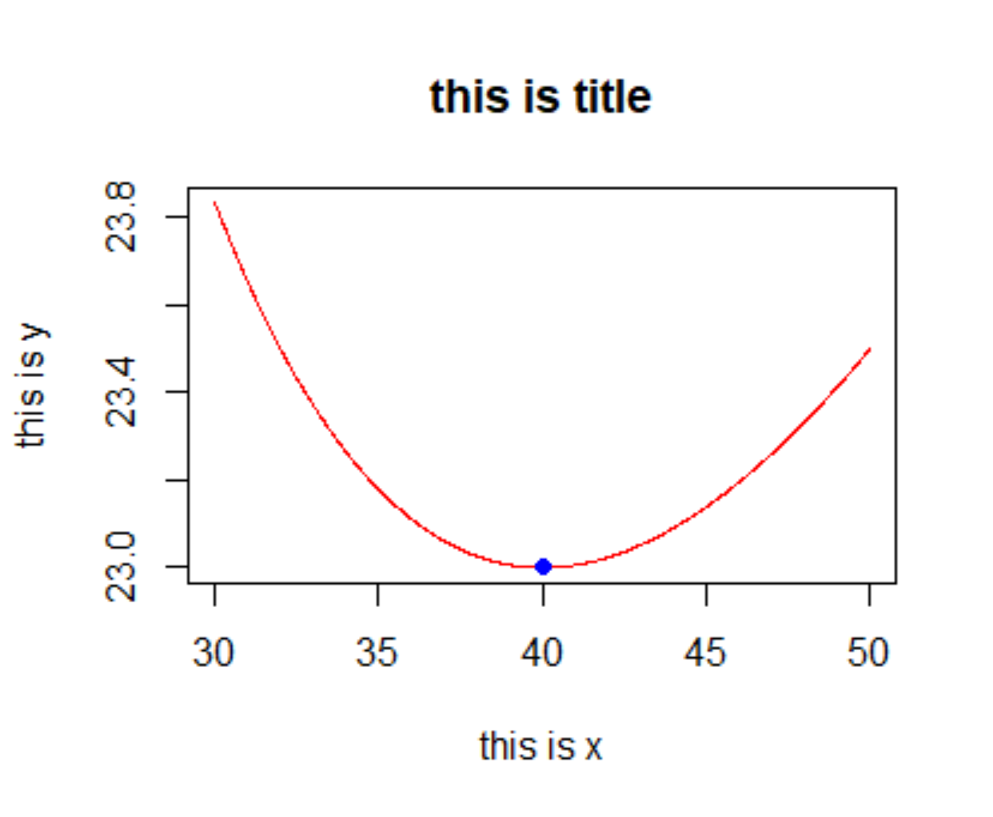
Optimizing a Function in R
The following code finds a local minimum value of a one-variable function within a given interval [a, b]:
optimize(f,c(a,b)) or: optimize(f,lower=a,upper=b)
Example:
f=function(q) q/4+3+400/q
y=optimize(f,c(0,100))
print (y)
$minimum
[1] 40.00001
$objective
[1] 23
plot(f,from=30,to=50,n=1000,col="red",xlab="this is x",ylab="this is y",main="this is title")
points(y$minimum,y$objective,col="blue",type="o",pch=19)

Slide 13
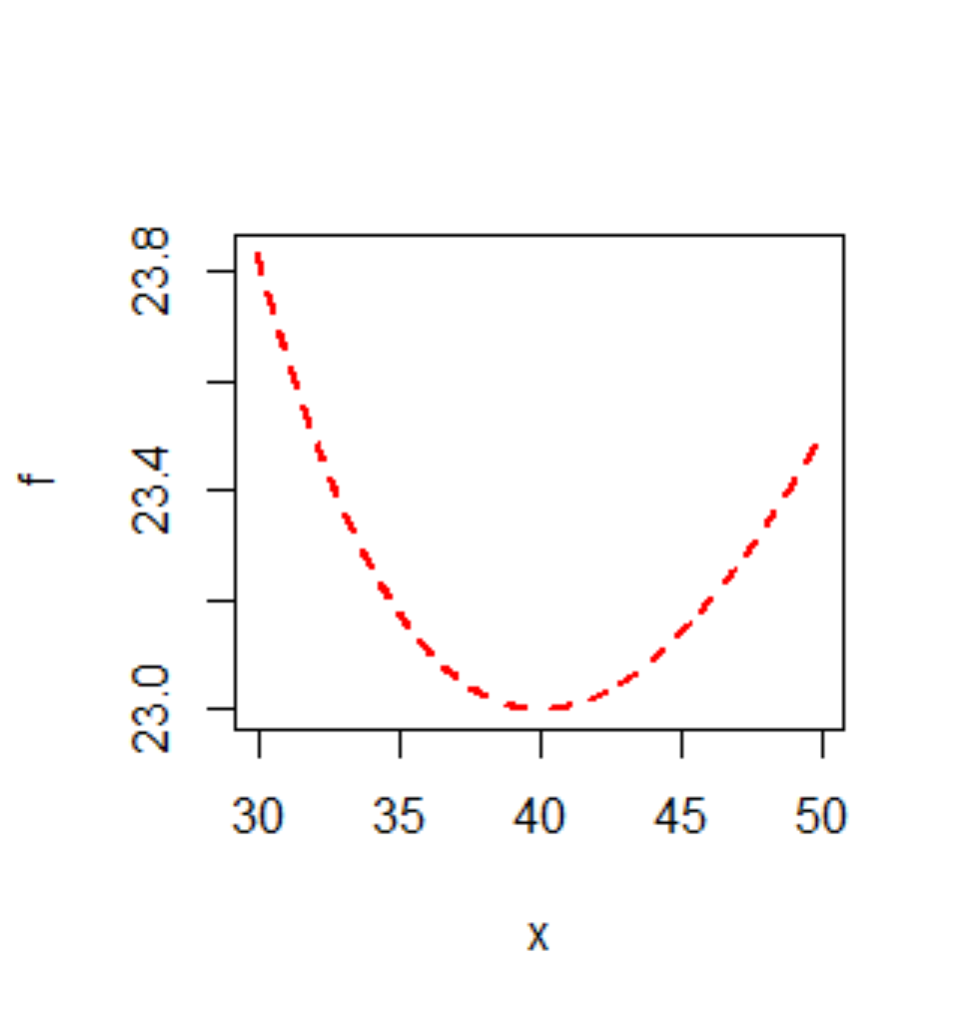
Plotting a Function in R
plot(f, from = 0, to = 1, n = 101, col="red", lwd=1, lty=1)
f: function
from, to: the interval for the graph
n: the number of points to evaluate betweee “from” and “to” values.
lty, lwd: set line types and thickness
Example:
f=function(q) q/4+3+400/q
plot(f,from=30,to=50,n=1000,col="red“)
or just type:
plot(f,30,50,col="red")
You can also determine the line type and thickness:
plot(f,from=30,to=50,n=1000,col="red",lwd=2, lty = 8)

Slide 14
Extra Examples (Strongly Recommended for Exam)

Slide 15

Example
Find $\frac{d}{dx}\left(\sqrt{x}\right)$.

Slide 16
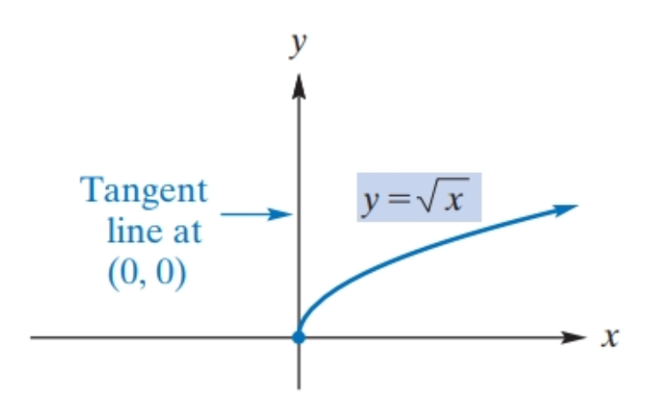
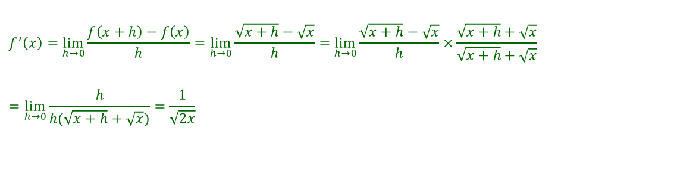
Solution
$$f^{′}\left(x\right)=\lim_{h→0}{\frac{f\left(x+h\right)−f\left(x\right)}{h}}=\lim_{h→0}{\frac{\sqrt{x+h}−\sqrt{x}}{h}}=\lim_{h→0}{\frac{\sqrt{x+h}−\sqrt{x}}{h}}×\frac{\sqrt{x+h}+\sqrt{x}}{\sqrt{x+h}+\sqrt{x}}$$
$$=\lim_{h→0}{\frac{h}{h(\sqrt{x+h}+\sqrt{x})}}=\frac{1}{\sqrt{2x}}$$
Remark: $\sqrt{x}$ is not differentiable at (0,0). It is defined only when $x>0.$

Slide 17
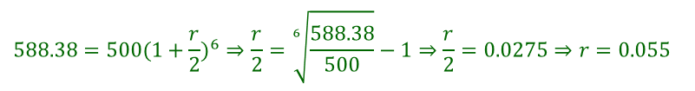

Example
Suppose that $\$500$amounted to $\$588.38$in a savings account after three years. If interest was compounded semiannually, find the nominal rate of interest, compounded semiannually, that was earned by the money.
Solution:
The semiannual rate was $2.75\%$, so the nominal rate was $5.5\%$ compounded semiannually.
$$588.38=500(1+\frac{r}{2})^{6}⇒\frac{r}{2}=\sqrt[6]{\frac{588.38}{500}}−1⇒\frac{r}{2}=0.0275⇒r=0.055$$

Slide 18

Example
How long will it take for $\$600$ to amount to $\$900$ at an annual rate of $6\%$ compounded quarterly?

Slide 19

Solution
$$S=P{\left(1+\frac{r}{k}\right)}^{ky}⇒900=600{\left(1+\frac{0.06}{4}\right)}^{4y}$$
$$⇒{\left(1.015\right)}^{4y}=1.5$$
$${⇒ln\left(1.015\right)}^{4y}=\ln{(1}.5) \\ ⇒(4y)\ln{1}.015=\ln{(1}.5) \\ ⇒y=\frac{1}{4}\frac{\ln{(1}.5)}{\ln{(1}.015)}≈6.8083 years$$
$$=6 years, 9\frac{1}{2} months$$

Slide 20

Second Derivative Tests
Example: Test the following for relative maxima and minima for: $y=18x−\frac{2}{3}x^{3}$.

Slide 21
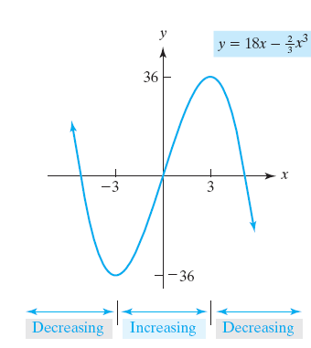

Solution
$$y′=2\left(3+x\right)\left(3−x\right) \\ y′′=−4x$$
$$\text{When} y′=0, \text{we} \text{have} x=±3$$
$$\text{When} x=+3, y′′=−4\left(3\right)=−12<0 \\ \text{When} x=−3, y′′=−4\left(−3\right)=12>0$$
Relative minimum when $x=−3$.

Slide 22

Example: Minimizing Average Costs
A manufacturer’s total-cost function is given by $c=c\left(q\right)=\frac{q^{2}}{4}+3q+400$ where $c$ is the total cost of producing q units. At what level of output will average cost per unit be a minimum? What is this minimum?

Slide 23

Solution
Average-cost function is
$$\bar{c}=\bar{c}\left(q\right)=\frac{c}{q}=\frac{\frac{q^{2}}{4}+3q+400}{q}=\frac{q}{4}+3+\frac{400}{q}$$
To find critical values, we set
$$\frac{d\bar{c}}{dq}=0=\frac{q^{2}−1600}{4q^{2}}⇒q=40 \text{since} q>0$$
$\frac{d^{2}\bar{c}}{dq^{2}}=\frac{800}{q^{3}}$ is positive when $q=40$, which is the only relative extremum. The minimum average cost is
$$\bar{c}\left(40\right)=\frac{40}{4}+3+\frac{400}{40}=23$$

